Slide 1
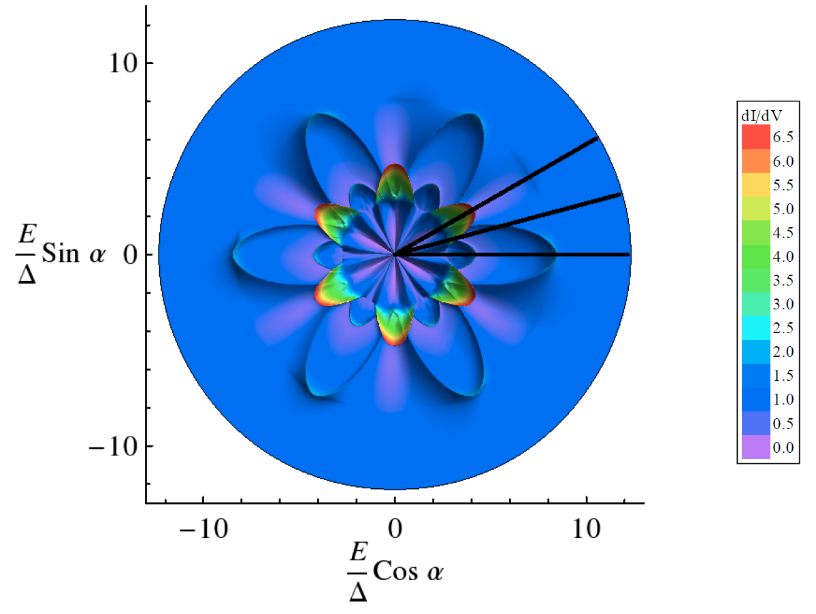

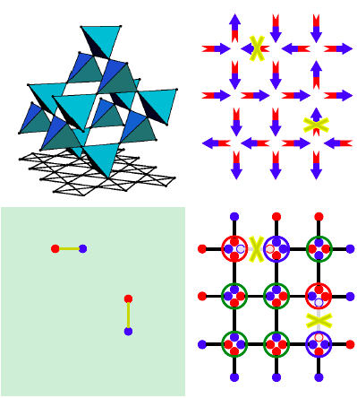
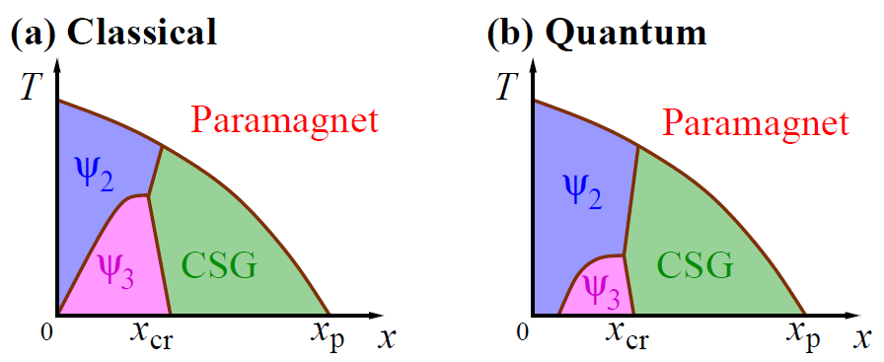

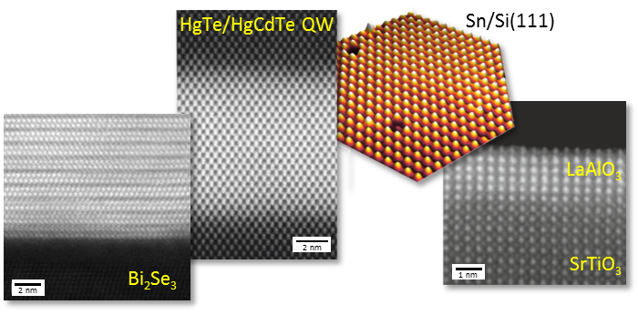
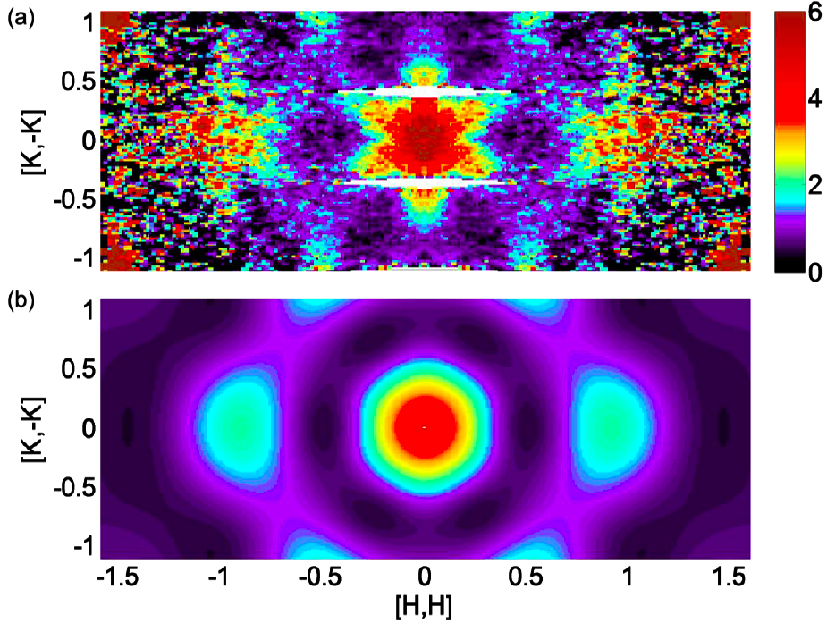
Motivation / Introduction / Abstract
Fonts and sizes
Text box containing the central research goals of this project, preferably as itemized list
Box may contain a figure if appropriate.
Standard font: Arial
Font size in boxes is 36
Font size for box headline is 60
Box headline should start 1 cm from left and upper box edge
References in italics, font size 24
Boldface, italics, and colored font can be used to highlight text, but do not use excessively
Methodology / Analysis
Project progress / Preliminary work
Boxes: number, size, and arrangement of boxes can be chosen freely as required
All projects are asked to conform to the same style and layout of the following boxes: Upper left (“Motivation / Introduction / Abstract") and lower right (“Conclusion / Summary / Outlook”)
We recommend to use the 2nd box for a short description of the preliminary work ("Vorarbeiten")
Keep texts short, bullet-point style
Logos: Please use the Cluster logo, the University logos can be replaced by the corresponding institution logo (e.g. IFW, HZDR, …)
Conclusion / Summary / Outlook
References
Bullet list
[1] Author 1 and Author 2, Journal, Volume, Year
[2] Author 1, Author 2, and Author 3, Journal, Volume, Year
[3] …
[4] …
[5] …
[6] …
[7] …
[8] …
[9] …
[10] …
[11] …

